Slide 1
ICS CYBERSECURITY for University of Alberta SAFETY AND RISK MANAGEMENT
Jose Alvarado, PEng, GICSP Paul Haughey, CET, PMP, GICSP
ENGG404 Lecture November 2019

Slide 2


Introductions
Mr. José Alvarado
P.Eng, GICSP
Department Manager, ICS Cybersecurity
Mr. Paul Haughey
CET, PMP, GICSP
Automation and ICS Cybersecurity Specialist
Notes:
Mr. José Alvarado has sound experience in several engineering fields, more particularly through the carrying out of power generation control projects and the integration of industrial IP networks and SCADA systems. He also participated in the upgrade of control and telecommunication systems including design, technical specifications, and commissioning within the scope of several Utility and Oil & Gas projects. José developed further expertise in the implementation of communication protocols, programming and commissioning of soft PLCs, RTUs, networking devices, loop controllers, and HMIs. He also implements data acquisition and telecommunication systems. When the firm expanded into the oil & gas market in 2012, Mr. Alvarado relocated to Western Canada to assist in organizing and launching the new Calgary Expertise Centre. Currently, he coordinates and leads BBA’s national Industry 4.0 Cybersecurity initiative within the ICS Cybersecurity group.
Mr. Paul Haughey has more than 30 years experience working with industrial control systems, operational technology (OT) security and embedded controllers. He has worked with clients in Oil & Gas, Pipeline, Power Utility, Mining, Water and Waste Water treatment, Food and Beverage, Manufacturing and Offshore processes. Paul graduated from NAITs Telecommunications program. With experience programming and commissioning safety instrumented systems, HMI/SCADA, programmable logic controllers, remote terminal units, robotics and software development. With expertise in change management, data management, Internet of Things and cybersecurity. He has taught Distributed Control Systems (DCS) classes at the local college. He has started two automation companies over the past fifteen years and currently works with BBA as a team lead and ICS Automation and Cybersecurity Specialist.

Slide 3








OUR TECHNICAL CAPABILITIES
Studies, audits and benchmarking
Design and optimization
Safety and environmental protection
Economic analyses and asset management
Equipment selection, modernization and optimization
Operations and maintenance support
Regulatory compliance
Project management and control
Testing and commissioning
Notes:
Multi discipline consulting engineering
Electrical, Automation, Telecom, Cybersecurity, Civil, Mechanical, Environment
Approx 25% of the time is spend working in the field at clients facilities

Slide 4










Our 10 golden rules
Always wear your seatbelt
while in a moving vehicle.
If working at heights, have proof of valid BBA training and always respect existing regulations.
If working in confined spaces, have proof of valid BBA training and always respect existing regulations.
If using a lock, have proof of valid BBA training and always respect existing regulations.
Always hold a valid work
permit when required.
.
Never use a mobile device while driving and stay within speed limits.
Never work or drive while impaired by alcohol, drugs or medication.
Never place yourself under a suspended load.
Never enter electrical installation areas without proof of valid BBA training, unless accompanied by qualified personnel.
Always cordon off your work area with the appropriate tape and respect such set boundaries.

Slide 5

LEARNING OUTCOMES
Identify the process and approaches used to protect an organization from a cyber attack
Identify challenges and strategies for cyber threats that you as an engineer will come across
Case study to reference RME5 Incident investigation, analysis, follow-up and action
Cyber program evaluation and continuous improvement reference to REM6
PEOPLE
PROCESS
TECHNOLOGIES

Slide 6
AN OVERVIEW OF ICS CYBERSECURITY
ICS Cybersecurity
IT / OT
Myths
Business Drivers
People, Process, Technology
Audit vs Assessment
Vulnerabilities
Bowtie
Defense in Depth
Remediation Strategy
Cyber incidents
PEOPLE
PROCESS
TECHNOLOGIES
Notes:
Understanding the complexities of ICS Cybersecurity. There is much more to it than installing a firewall. Doing the most to protect people and assets.
“Technology by itself produces a very limited protection if it is not combined with a process to manage that technology and with people trained on how to use it effectively”

Slide 7
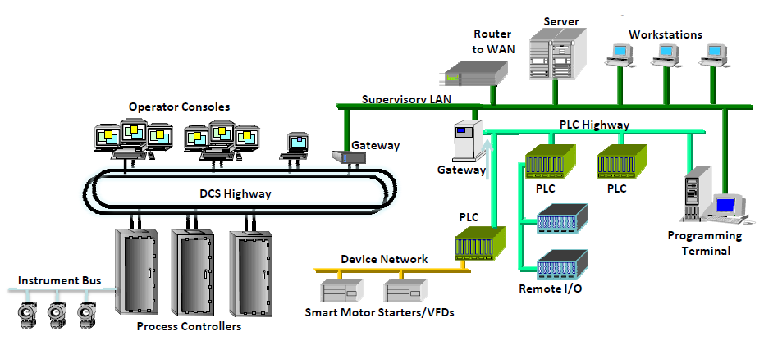
A QUICK OVERVIEW OF ICS ELEMENTS
SCADA
HMI
PLC
RTU
IED
Notes:
The equipment is sometime very old and not designed with security in mind
DH+, Modbus, Profibus, DeviceNet
PLC and DCS are now becoming more similar, prev PLC on/off control, DCS process control (PID)
Ethernet was non deterministic, not trusted for control systems
IED – Intelligent Electronic Devices
HMI – Human-Machine Interface
DCS – Distributed Control System
RTU – Remote Terminal Unit
PLC – Programmable Logic Controller
SIS - Safety Instrumented System
SCADA – Supervisory Control and Data Acquisition

Slide 8
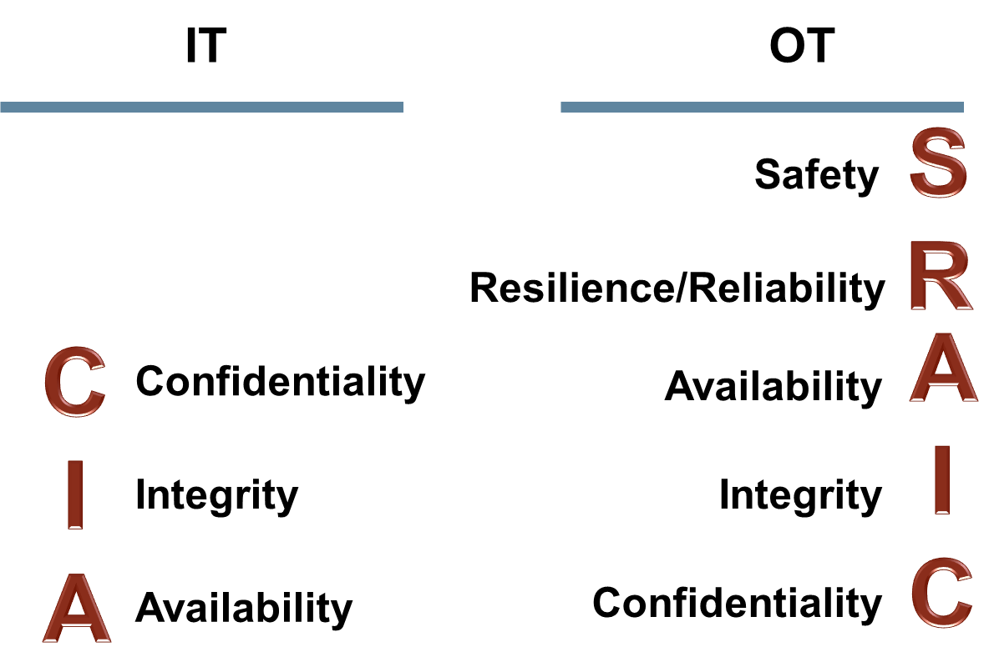
IT AND OT CYBERSECURITY NEEDS
Notes:
IT OT cyber in the title
Safety is King for Operations
Followed by reliability and availability
Protecting information is important but is not the #1 item
IT/OT knowledge share
IT knowledge of network equipment - OT knowledge of data flow and process
There are significant differences between IT and OT
Both require a lot of expertise, talent and experience to be successful
IT Processes and doctrines do not necessarily “fit” into OT systems
It is important that IT works with OT needs to understand the reliability impacts of information security technologies before their deployment
IT/OT groups need to work collaboratively sharing expertise

Slide 9
DIFFERENTIATORS BETWEEN IT AND OT/ICS
Cybersecurity Area | Information Technology (IT) | Industrial Control System (ICS)
Technology Support Lifecycle | 2-3 years | 10-20 years (but compressing)
Regulatory Standards Compliance | Some regulatory oversight (ISO 27001/02, ITIL, CoBIT, etc.) | Only specific regulatory guidance Mature Standards for some sectors i.e. IEC 62443, NERC CIP Standards
Internal Compliance Programs (Policies, procedures, processes) | Usually good. Established IT cyber security policies, processes, and some good IT practices | Essential in the Critical Infrastructure (CI) sector Other CI entities – just getting started
Availability | Medium importance – Reboots Allowed | Extremely important!
Security Awareness | Usually good | Generally less than adequate, but improving
Defensive Technologies & Practices | Good practices and evolving | Good in some CI sectors (power grid) Other CI sectors – at early stages
Malware Prevention (AV) | Mature established practices. Automated deployment | Limited to some cyber assets Difficult to deploy current updates.
Patching Practices | Mature established practices. Automated deployment | Ineffective practices – long lag from release to implement. Difficult to deploy requiring outage windows
Configuration Management | Good but room for improvement | Area of weakness – “Broke-Fix” Environment
Perimeter Protection (Security Zones) | Good and evolving/hardening | Early stages in some CI sectors – basic Access Point protection (EAP/PEP)
IDS/IPS SIEM | Good and evolving/hardening | Early stages for most ICS operators
Physical Security Practices | Good to excellent for corporate data centres | Usually good, but often remote and unmanned sites. Often no central monitoring
Notes:
Availability is most important
ICS is more mature in regulated environments
Patching and anti virus has challenges
SIEM is being used for larger companies, products are becoming more suited for ICS
Examples of harsh environments 60C to -20 C switch

Slide 10
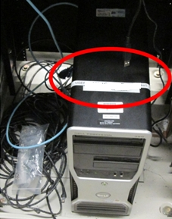
DEFINITIONS
Cybersecurity
Vulnerability
Threat
Risk
Control
Source:All-In-One CISSP by Shon Harris and Fernando Maymi
Notes:
Cybersecurity is the practice of defending computers, servers, mobile devices, electronic systems, networks, and data from malicious attacks. It's also known as information technology security or electronic information security. The term applies in a variety of contexts, from business to mobile computing, and can be divided into a few common categories: Network security, Application security, Information security, Operational security, Disaster recovery and business continuity
Vulnerability: is a weakness in a system that allows a threat source to compromise its security.
Threat: is any potential danger that is associated with the exploitation of a vulnerability.
Risk: is the likelihood of a threat source exploiting a vulnerability and the corresponding business impact.
Control: or countermeasure is put into place to mitigate (reduce) the potential risk.

Slide 11
The Myths
CYBERSECURITY RISKS – AN INDUSTRY PERSPECTIVE
(Industry dependent)
VS
The Reality
System not connected to Internet
We have firewalls
Our facility is not a target
Our technology (PLCs/RTUs/DCS) is not easy to hack
Safety systems will prevent bad things
ICS-CERT – 245 Reported Incidents
Many Incidents NOT Reported
38% of ICS Incidents Classified as “Unknown”
Industrial Incidents:
Energy = 33%
Water = 5%
Chemical = 3%
Nuclear = 2%
Source: Using the ANSI/ISA-62443 Standards to Secure Your Control System – Volume 1
Source: 2013 Honeywell International
Notes:
It is not just the internet. We are connected locally and remotely trough VPNs.
SCADA and process control are now common topics at Hacker’s conferences.
80 % of control system incidents are unintentional
IEC61508/61511 certification doesn’t evaluate security, only process

Slide 12
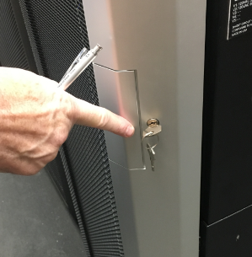
HOW TO PROTECT AN ORGANIZATION
“Technology by itself produces a very limited protection if it is not combined with a process to manage that technology and with people trained on how to use it effectively”
Remote Access
PEOPLE
PROCESS
TECHNOLOGY
Notes:
Someone needs to be accountable – the higher in management CIO, CISO, COO level
Holistic Approach to Cybersecurity – lack of a cybersecurity program can produce a false sense of security as it only focuses on one pillar or two but not on three of them
Integrates People, Process & Technology
Help organizations in answering simple questions:
Why I need to protect my cyber assets
What cyber assets I need to protect
How can I protect my cyber assets
Help organizations to maximize their cybersecurity investments to obtain the maximum return
Cybersecurity program is a continuous process and not just one time project

Slide 13
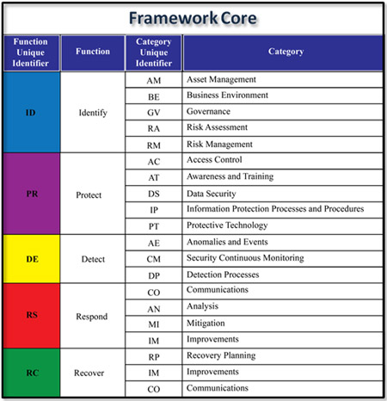
CYBERSECURITY PROGRAM
Program
Policy
Process
Procedure
Plans
Ref: http://www.isaca.org
Notes:
Cybersecurity Posture – NIST SP 800-30 Rev.1
The security status of an enterprise’s networks, information, and systems based on information assurance resources (e.g., people, hardware, software, policies) and capabilities in place to manage the defense of the enterprise and to react as the situation changes.
Program is a set of related measures or activities with a particular long term aim
Policy is a deliberate system of principles to guide decisions and achieve rational outcomes
Process a series of actions or steps taken in order to achieve a particular end
Procedure an established or official way of doing something
Plans an intention or decision about what one is going to do

Slide 14
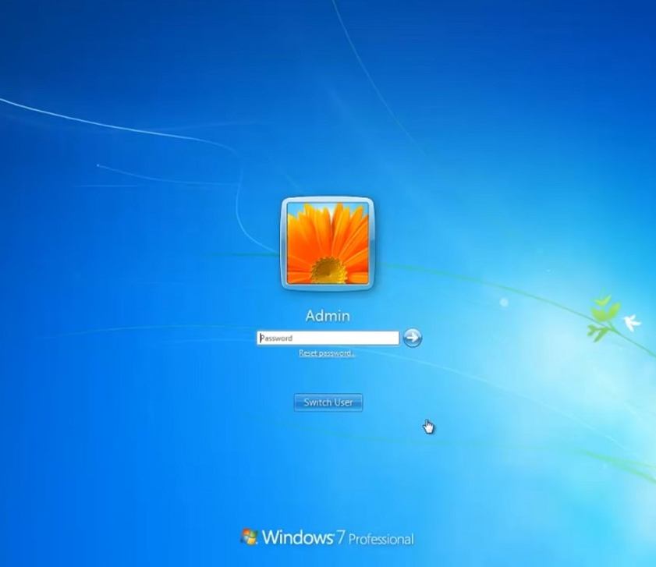
BUSINESS DRIVERS FOR AN ICS PROGRAM
Technology convergence
Orphaned ICS cyber assets insecure by design
Isolated “Island systems”
Sharing ICS operational data
No longer hypothetical or marketing hype
Should not have username
Notes:
Technology convergence (IT, OT, IoT, routable protocols, internet, wireless)
Isolated “Island systems” not common today
Business need for sharing ICS operational data across the corporate enterprise
Orphaned ICS cyber assets not supported (Windows XP, RTUs)
Many ICS equipment are ‘insecure by design’
No longer hypothetical or marketing hype – Daily news events of cyber attacks
Orphaned ICS cyber assets/systems are common (discontinued support)
Technology convergence (IT, OT, IoT, routable protocols, internet, wireless) - changed everything. Old days did not see ethernet to the plant floor, only proprietary protocols
Escalating business need for sharing ICS operational data across the corporate enterprise – has been the tipping point for the surge in cybersecurity risks
A history of separate technical resources among IT and ICS teams
Inadequate ICS cybersecurity skills or cybersecurity response readiness

Slide 15

BUSINESS DRIVERS FOR AN ICS PROGRAM
Top agenda item for Senior Executive
Insurance Liability Premiums
Subject to internal audits
More than an expected “Good Business Practice”
Mandatory Regulatory Compliance
Notes:
Cyber Security business risks will continue to be a top agenda item for Senior Executive and Risk Management teams
Insurance Liability Premiums being defined for Cyber Security Risks avg data breach $3.86M (6.4% increase), avg $148 stolen record (4.8% increase)
Subject to internal audits as part of the Risk Management practice
For many entities, cybersecurity is more than an expected “Good Business Practice”
Mandatory Regulatory Compliance for some Critical Infrastructure
Typical insure payout for a cybercecurity incident???
Out of 477 participating global companies spanning 17 industry sectors, the following costs were identified:
–Average total cost of a data breach: $3.86M (increased 6.4% from2017)
–Average cost per lost or stolen record: $148 (increased 4.8% from 2017)
*Data obtained from the PonemonInstitute LLC: “2018 Cost of a Data Breach Study: Global Overview ”

Slide 16
CYBERSECURITY MATURITY MODEL – LEVEL DEFINITIONS
Maturity level no. | Maturity level | Security level descriptions
1 | Initial / Ad hoc | Recognition of issues exist No standardized process Ad-hoc approaches
2 | Repeatable | Similar procedures are followed by different people for the same task No formal training or communication of standard processes Responsibility is left to the individual High degree of reliance of knowledge of individuals, therefore errors are likely
3 | Defined process | Procedures are standardized, documented and communicated through training Mandatory that the process should be followed Unlikely that deviation would be detected
4 | Managed and Measureable | Monitors and measures compliance with procedures, and takes action where process appear not to be effective Constant improvement Automation and tools are used in a limited manner
5 | Optimized | Processes have been refined to a level of best practice based on continuous improvement and maturity modeling IT is used in an integrated way to automate workflows Providing tools to improve quality and effectiveness
www.slideshare.net
Notes:
Maturity Level is a way to describe management effectiveness.
To manage cyber security risk, client are s targeting a ML4 Maturity Level.

Slide 17








AUDIT VS ASSESSMENT OF INDUSTRIAL CONTROL SYSTEMS
AUDIT Use specific standard Identify the standard Auditor needs to have knowledge of standard Compliance-focused Checklist-oriented PASS-FAIL | ASSESSMENT Use experience and practical knowledge Recognized standards and guidelines Achieve higher level of performance & exceed minimum compliance Expose different risk levels Not a PASS-FAIL approach
CYBERSECURITY GAPS
CYBERSECURITY POSTURE
Notes:
Snap shot in time

Slide 18
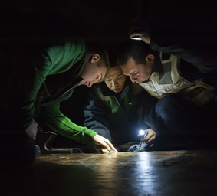
CyBERSECURITY Field Assessment Effort
OBSERVATION
EVALUATION
STUDY
Activities
ICS vulnerability reviews
Documentation reviews
Staff interviews
Legacy system update plans
Pen Testing
Risk Evaluation
Configuration reviews (e.g., firewall)
Observation of work performed by client
Physical security walk-through(s)
Port scans
Notes:
System architecture review
Or if you have a specific area of concern
Are the critical assets identified?
Are backups performed regularly?
Are cyber risks identified?
Is there a Champion, clear owner?
Is there a cyber awareness program?
Is there a Policy?
Is there an Incident response plan?
Obs: Provides a snap-shot of cybersecurity profile
Eval: Deeper review of overall cybersecurity profile and maturity
Study: Detailed cybersecurity review of targeted areas

Slide 19
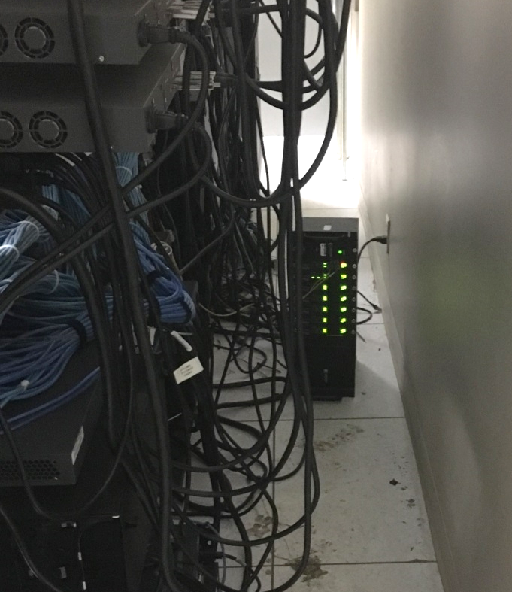
ICS Vulnerability Review
Threat
Asset
Vulnerability
Two Types of Reviews:
Passive vulnerability review
Active vulnerability review
RISK
Image: frsecure.com
Notes:
OT is afraid of using active tools, it can be risky
- Tenable - Rapid7

Slide 20
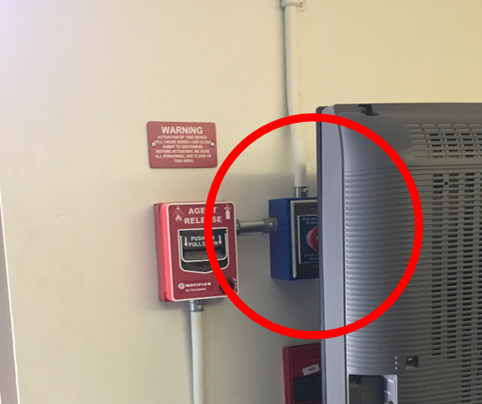
Top 10 ICS Vulnerabilities
Legacy Software/Equipment
Default Configuration
Lack of Encryption
Remote Access Policies
Policies and Procedures
Lack of Network Segregation
DDos Attacks
Web Application Attacks
Malware
Common Injection Manipulation
Source: https://www.checkpoint.com/downloads/products/top-10-cybersecurity-vulnerabilities-threat-for-critical-infrastructure-scada-ics.pdf
Notes:
Control systems are vulnerable from inside and outside the network
Industrial facilities could see operations impacted, regardless the condition of their system
Understanding ICS vulnerabilities
Equipment lifespan & Legacy Systems
Common mode of failures
ICS CERT

Slide 21
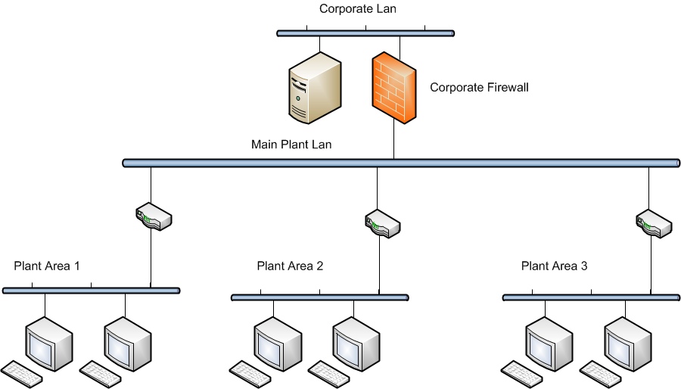

ASSESSMENT - IDENTIFY
Threats/Vulnerabilities
Critical Assets
Sniffer, Eavesdropping, Session Hijacking
Unauthorized Remote Access
Unauthorized Access
Malware, Virus, Worms, Spywares, Ransomware
SQL injection
Physical Attack
Impact
Operation disruption
Operation shutdown
Penalties
Loss of profit
Reputational damage
Explosion
Loss of human life
Outcome: Organization’s risk profile
Notes:
Common Vulnerabilities and Attacks
Ops to feed this process, maint, eng
Legacy Systems unable to integrate physical –logical secured architecture on applications.Systems: vulnerable to Viruses, Worms, Malwares, Spywares from portable devices
Industrial Protocols lacking encryption and authentication: Eavesdropping, Session Hijacking
Lack of proper segmentation and Defense in Depth: Compromised perimeter firewall can leave the entire network compromises
Insecure Database and improperly configured Active Directory: SQL injection attacks
Are networks segmented, HMIs patched, is there a policy in place to use the same laptop on the control system that you son used to surf the internet

Slide 22
Risk Assessment – Bow Tie Method
Threat
Preventative Controls
Cyber Incident
Corrective Controls
Impact
Cyber attack via compromise of 3rd party partners access to ICS
PR.IP-001 Information Classification & Protection
PR.IP-002 Configuration Change Management
PR.AC-001 Electronic Security Zones & Network Segmentation
PR.AC-002 Identity & Access Management
PR.AC-003 Privileged Access Management
PR.AC-004 Remote Access Controls
Threat
Top Event
Hazard
Impact
Qualitative Current State: Colours assigned based on Workshop
85.00%
Current State: Green means overall, this control is strong
Current State: Yellow means there are some gaps, but it is still functional
Current State: Red means there are major gaps and it is essentially not functional
Control
Control
Control
Control
Current Effectiveness Value: Calculated based on KPIs / metrics defined in the controls list mapping (see Conformance Dashboard)
Notes:
This is a Bow Tie method to assess risk
It look like a bow tie, threat on the left, impact on the right – event shown in the middle
Preventative controls on left, event or incident in the middle occurred then attempt to contain
Most organizations find it difficult to agree on likelihood, and little information is available to help. Documenting assumptions being used can be used to drive investment.
Likelihood of an attempt
Likelihood that they will succeed
Likelihood is evaluate twice during the risk assessment process. Evaluated without considering countermeasures and again with countermeasures and effectiveness.

Slide 23
Risk Assessment – Bow tie METHOD
Privilege Abuse
Cybersecurity Incident
Service Disruption / Degradation / Corruption
65.63%
85.00%
75.00%
50.00%
73.00%
50.00%
50.00%
56.25%
58.33%
51.67%
41.00%
PR.IP-002
Configuration Change Management
PR.AC-002
Identity & Access Management
PR.AC-003
Privileged Access Management
PR.AC-005
Segregation of Duties
PR.AC-006
Physical Security
PR.AT-001
Cybersecurity Awareness Program
PR.AT-002
Cybersecurity Training Program
ID.AM-001
Asset Inventory & Classification
ID.AM-002
Data Flow Diagrams
RS.RP-001
Cybersecurity Incident Response Plan (CIRP)
RC.RP-001
Backup & Recovery Program
Disgruntled Employee (DoS / Data Corruption)
Insider Attack
Data Theft / Leakage
65.63%
85.00%
79.33%
75.00%
95.00%
45.00%
70.00%
67.50%
51.67%
PR.IP-001
Information Classification & Protection
PR.AC-001 Electronic Security Zones & Network Segmentation
PR.AC-002 Identity & Access Management
PR.AC-003 Privileged Access Management
PR.AC-004 Remote Access Controls
PR.AC-006
Physical Security
PR.PT-001
Ports & Services
PR.PT-002
Patch Management
RS.RP-001
Cybersecurity Incident Response Plan (CIRP)
Unauthorized Devices
Safety Incident
65.63%
85.00%
75.00%
73.00%
51.67%
N/A
PR.IP-001
Information Classification & Protection
PR.AC-001 Electronic Security Zones & Network Segmentation
PR.AC-003
Privileged Access Management
PR.AC-006
Physical Security
RS.RP-001
Cybersecurity Incident Response Plan (CIRP)
Emergency Management Plan (EMP)
Data Theft
Fraud
65.63%
79.33%
75.00%
95.00%
50.00%
73.00%
45.00%
70.00%
67.50%
56.25%
58.33%
51.67%
PR.IP-001
Information Classification & Protection
PR.AC-002 Identity & Access Management
PR.AC-003 Privileged Access Management
PR.AC-004 Remote Access Controls
PR.AC-005
Segregation of Duties
PR.AC-006
Physical Security
PR.PT-001
Ports & Services
PR.PT-002
Patch Management
PR.PT-003
Malicious Code Prevention
ID.AM-001
Asset Inventory & Classification
ID.AM-002
Data Flow Diagrams
RS.RP-001
Cybersecurity Incident Response Plan (CIRP)
Foundational Controls
Regulatory Violation / Legal Action
65.00%
80.00%
30.00%
N/A
N/A
N/A
N/A
35.00%
N/A
56.25%
58.33%
51.67%
41.00%
ID.RA-001
Risk Scenario Workshops
ID.RA-002
Vulnerability Assessments
ID.RA-003
Cybersecurity Risk Management
ID.BE-001
Corporate Policy Framework
ID.GV-001
Cybersecurity ICP
ID.GV-002
Compliance Management
ID.GV-003
Cybersecurity Procedures
RS.RP-003
Security Monitoring
PR.MA-001
Cybersecurity Maintenance-Program
ID.AM-001
Asset Inventory & Classification
ID.AM-002
Data Flow Diagrams
RS.RP-001
Cybersecurity Incident Response Plan (CIRP)
RC.RP-001
Backup & Recovery Program
Threat
Top Event
Hazard
Impact
Qualitative Current State: Colours assigned based on Workshop
85.00%
Current State: Green means overall, this control is strong
Current State: Yellow means there are some gaps, but it is still functional
Current State: Red means there are major gaps and it is essentially not functional
Control
Current Effectiveness Value: Calculated based on KPIs / metrics defined in the controls list mapping (see Conformance Dashboard)
Control
Control
Control

Slide 24
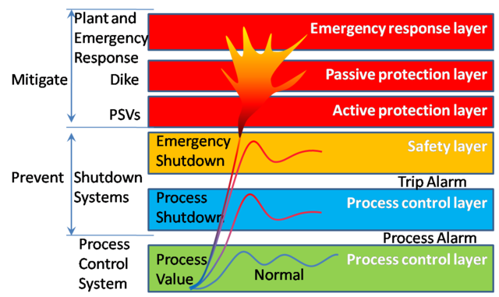
Defence in Depth
Functional Safety – LOPA
Defense in Depth Strategy Elements
Risk Management Program | Host Security
Cybersecurity Architecture | Security Monitoring
Physical Security | Vendor Management
ICS Network Architecture | The Human Element
ICS Network Perimeter Security
https://en.wikipedia.org/wiki/File:Safety_Layer_Protection.png
Recommended Practise: Improving ICS cybersecurity with defence in depth strategies – ICS Cyber Emergency Response Team September 2016
Notes:
A wide range of network technologies are deployed to achieve the desired segregation. These include firewalls, routers with access control lists, switches with VLANs, and through physical network isolation (sometimes referred to as air-gapping). Intrusion Detection Prevention system (IDPS) is deployed at strategic network zones to alert at anomalous and suspicious traffics.
A rigorous cyber risk assessment methodology that consists of contextualization, quantification and mitigation like LOPA is lacking
Risk Management Program
Identify Threats
Characterize Risk
Maintain Asset Inventory
Cybersecurity Architecture
Standards / Recommendations
Policy
Procedures
Physical Security
Field Electronics Locked Down
Control Center Access Controls
Remote Site Video, Access Controls, Barriers
ICS Network Architecture
Common Architectural Zones
Demilitarized Zones (DMZ)
Virtual LANs
ICS Network Perimeter Security
Firewalls / One-Way Diodes
Remote Access & Authentication
Jump Servers / Hosts
Host Security
Patch and Vulnerability Management
Field Devices
Virtual Machines
Security Monitoring
Intrusion Detection Systems
Security Audit Logging
Security Incident and Event Monitoring
Vendor Management
Supply Chain Management
Managed Services / Outsourcing
Leveraging Cloud Services
The Human Element
Policies
Procedures
Training and Awareness

Slide 25
What to keep out - Security Level
Security level | Security level descriptions
SL0 | No specific requirement or security protection necessary
SL1 | Protection against casual or coincidental violation
SL2 | Protection against intentional violation using simple means with low resources, generic skills and low motivation
SL3 | Protection against intentional violation using sophisticated means with moderate resources, IACS specific skills and moderate motivation
SL4 | Protection against intentional violation using sophisticated means with extended resources, IACS specific skills and high motivation
Notes:
From IEC 62443

Slide 26
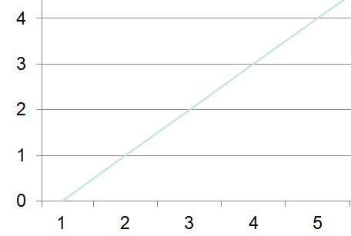
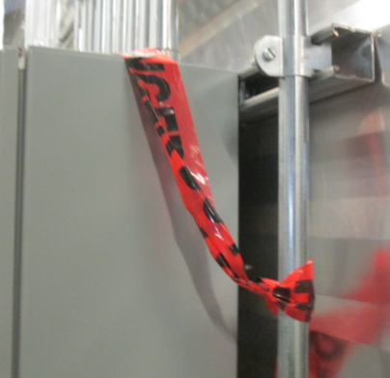
Security Level vs Maturity Level
Desired Security Posture
Protection against:
intentional violation
sophisticated means
moderate resources
IACS specific skills
moderate motivation
Security Level
Managed and Measureable
Maturity Level
Notes:
there is no relationship between maturity level and security level.
The energy industrial sector is seen to adopt a high SL and high ML posture (light green zone in the diagram) with Oil and Gas generally adopts the SL3 quadrant while Nuclear generally adopts the SL4 quadrant.
Protection against intentional violation using sophisticated means with moderate resources, IACS specific skills and moderate motivation

Slide 27
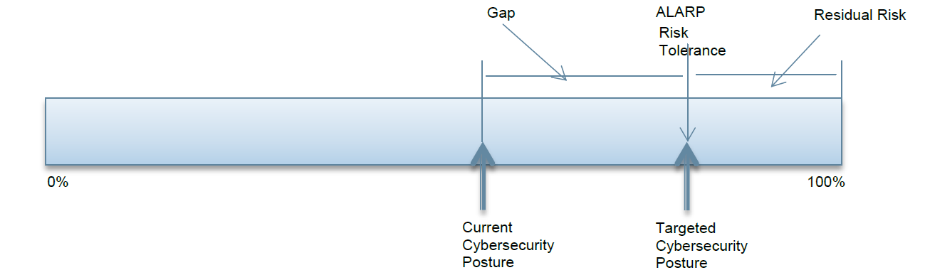
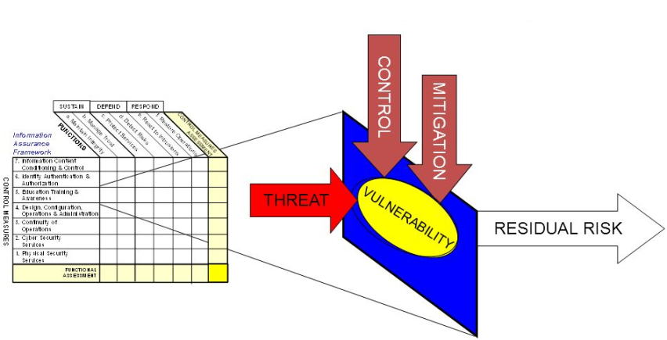
Developing a remediation plan
AVOID
REDUCE
ACCEPT
TRANSFER
RISK
After a certain point control effectiveness remains the same regardless of the investment
https://slideplayer.com/slide/6286990/
Notes:
Determine cybersecurity posture: How well do you protect, detect and respond to cyber threats and events
C2M2 cybersecurity capability mature model (C2M2) to measure the maturity of an organizations cybersecurity capabilities
As low as reasonably practical to be effective
Maturity level = Desired end state
Gap: no action, remediate, insure
Thus, there is no such thing as 100% protection.
Control metrics (kpi) + Self-assessment = current cybersecurity posture
Target posture (cyber risk tolerance) – current posture = Gaps
Gaps -> Defining risk treatment options -> Cyber remediation plan
If residual risk exceeds the tolerable risk the organization shall determine id the residual risk shall be accepted, transferred or mitigated based on the organizations policy.

Slide 28
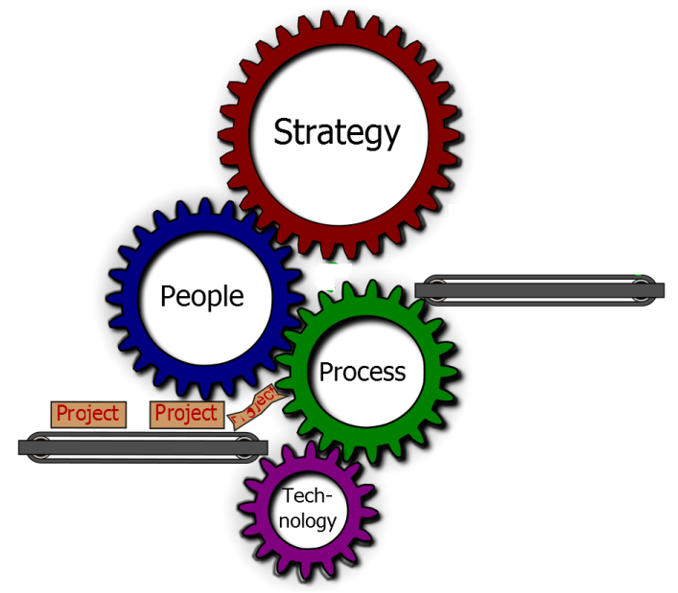
DEVELOP, IMPLEMENT & EXECUTE A REMEDIATION STRATEGY
Considerations:
Stakeholder input
Clients risk tolerance
Cyber maturity model target
Immediate areas of concern
80/20 Rule
Core KPIs
“Best bang for the buck”
Quick wins
Number of gaps addressed
Risk reduction achieved
What keeps you up at night?
Remediation
Strategy
PLANNING
https://ecaminc.com/index.php/services/strategy
Notes:
Add notes

Slide 29

DEVELOP PRIORITIZATION CRITERIA
Risk-based
Investment-based
Asset criticality
Threats
Regulatory
Impacts
Critical infrastructure
Effectiveness
Return on investment
Complexity
Resources
Remediation duration
Remediation cost
Remediation effort
Notes:
Ensure that your cyber priorities are inline with the business need. It might note make sense to install a bunch of firewalls or security solutions
If you are still working with 20 years old PLCs that are causing unplanned outages

Slide 30
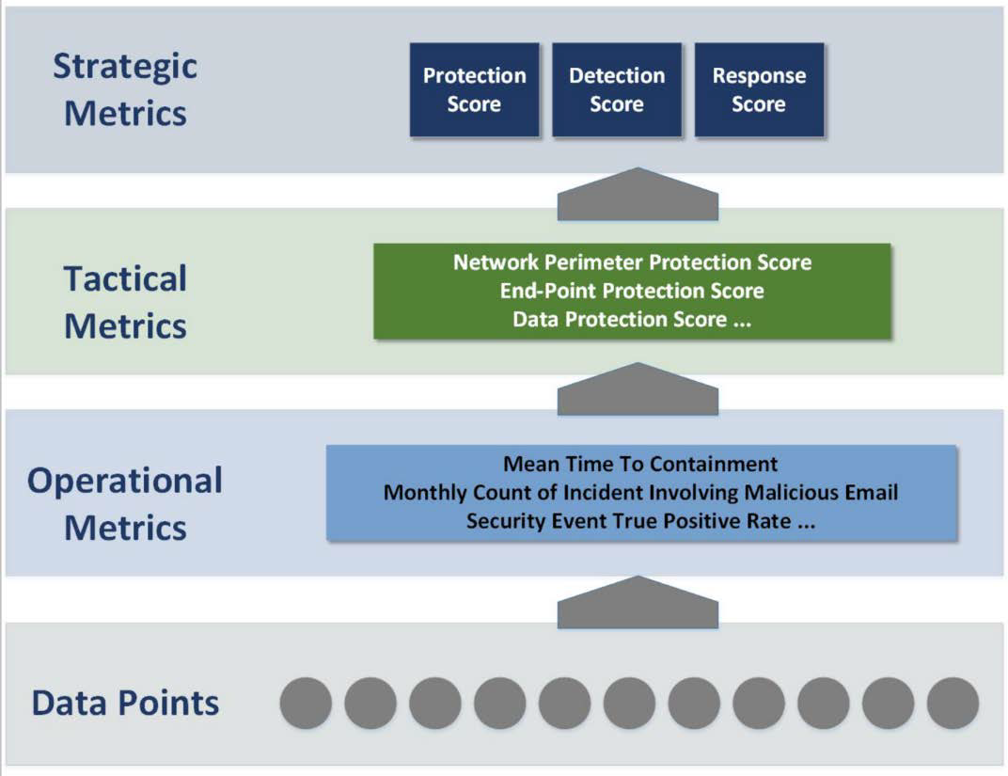
Cybersecurity Program – EVALUATION AND IMPROVEMENT
Sampling Evidence
Compliance Monitoring
Audits
Spot Checks
Self Certification
Monitor KPIs
Reference to RME6
program evaluation and continuous improvement.
EPRI
Creating Security Metrics for the Electric Sector

Slide 31
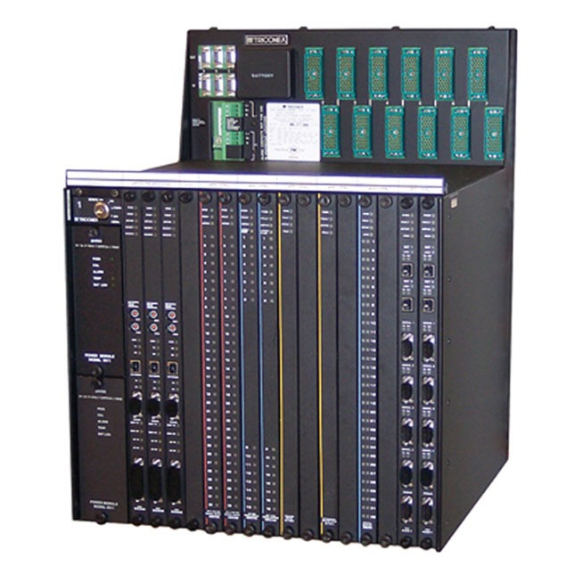
CYBER INCIDENT | TRITON
HatMan—Safety System Targeted Malware also known as TRITON and TRISIS.
Background
Reference to RME5
Incident investigation, analysis, follow-up and action.
Company: not disclosed
Location: Middle East
Date: December 2017
Zero day bug affects Triconex Tricon safety controllers
Allows an attacker to read/modify memory contents and execute arbitrary
Process fail could result in physical consequences.
Ref: Dept of Homeland Security and Schneider Electric
Notes:
Zero day bug affects Triconex Tricon safety controllers by modifying in-memory firmware to add additional programming. The extra functionality allows an attacker to read/modify memory contents and execute arbitrary code on demand through receiving specially-crafted network packets.
HatMan consists of two pieces: a PC-based component to communicate with the safety controller and a malicious binary component that is downloaded to the controller.
Safety controllers are used in a large number of environments, and the capacity to disable, inhibit, or modify the ability of a process to fail safely could result in physical consequences.

Slide 32
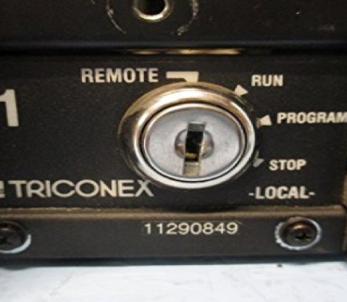
CYBER INCIDENT | TRITON
Results
Controllers entered a failsafe mode
First time the cybersecurity world had seen code deliberately designed to put lives at risk.
Our client now has a robust network with improved reliability and performance. The facility is designed and ready for digital substation automation and future regulatory requirements.
José Alvarado Manager– ICS Cybersecurity
https://www.technologyreview.com/s/613054/cybersecurity-critical-infrastructure-triton-malware/
https://www.fireeye.com
Notes:
Some controllers entered a failsafe mode as the hackers attempted to reprogram them, causing related processes to shut down and allowing the plant to spot the attack.
In attacking the plant, this was the first time the cybersecurity world had seen code deliberately designed to put lives at risk.
Hackers accessed the petrochemical company’s corporate IT network since 2014.
From there, they eventually found a way into the plant’s own network, most likely through a hole in a poorly configured firewall that was supposed to stop unauthorized access.
They then got into an engineering workstation, either by exploiting an unpatched flaw in its Windows code or by intercepting an employee’s login credentials.
The victim of the Triton attack had ignored multiple antivirus alarms triggered by the malware.
Failed to spot some unusual traffic across its networks.
Workers at the plant had also left physical keys that control settings on Triconex systems in a position that allowed the machines’ software to be accessed remotely.

Slide 33

CYBER INCIDENT | Cyber Attack on the Ukrainian Power Grid
Power outages were due to a third party’s illegal entry into the company’s computer and SCADA systems
Background
Reference to RME5
Incident investigation, analysis, follow-up and action.
Company: Kyivoblenergoa regional electricity distribution company Location: Ukraine
Date: December 23, 2015
A foreign attacker remotely controlled the SCADA distribution management system.
Seven 110 kV and 23 35 kV substations were disconnected for three hours
The attack impacted 225,000 customers and required the manual operations in response to the attack.
https://www.nerc.com/pa/CI/ESISAC/Documents/E-ISAC_SANS_Ukraine_DUC_18Mar2016.pdf
Notes:
A foreign attacker remotely controlled the SCADA distribution management system.
Ukrainian government officials claimed the outages were caused by a cyber attack, and that Russian security services were responsible for the incidents.
Based on the DHS report, three Ukrainian oblenergos (distribution) experienced coordinated cyber attacks that were executed within 30 minutes of each other. The attack impacted 225,000 customers and required the oblenergos to move to manual operations in response to the attack.

Slide 34
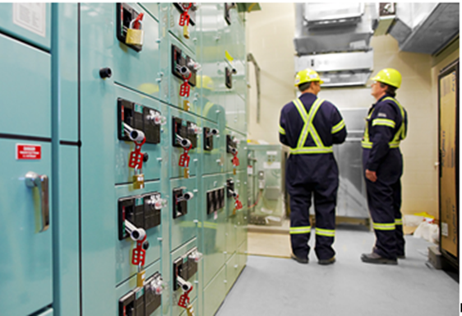
CYBER INCIDENT | Cyber Attack on the Ukrainian Power Grid
Results
The cyber attacks in Ukraine are the first publicly acknowledged incidents to result in power outages.
The motive and sophistication of this power grid attack is consistent with a highly structured and resourced actor.
Our client now has a robust network with improved reliability and performance. The facility is designed and ready for digital substation automation and future regulatory requirements.
José Alvarado Manager– ICS Cybersecurity
Notes:
The cyber attacks in Ukraine are the first publicly acknowledged incidents to result in power outages.
The motive and sophistication of this power grid attack is consistent with a highly structured and resourced actor. This actor was co‐adaptive and demonstrated varying tactics and techniques to match the defenses and environment of the three impacted targets.
The attackers demonstrated a variety of capabilities including:
spear phishing emails,
variants of the BlackEnergy 3 malware,
malware in Microsoft Office documents to gain a foothold into the Information Technology (IT)
harvest credentials and information to gain access to the ICS network.
The attackers showed expertise, not only in network connected infrastructure; such as Uninterruptable Power Supplies (UPSs), but also in operating the ICSs through supervisory control system; such as the Human Machine Interface (HMI)
Used telephone systems to generate thousands of calls to the energy company’s call center to deny access to customers reporting outages.
The strongest capability of the attackers was their capability to perform long‐term reconnaissance operations required to learn the environment and execute a highly synchronized, multistage, multisite attack.

Slide 35
SUMMARY
People, Process and Technology a holistic approach
Many unique challenges securing cyber assets at industrial facilities
Cybersecurity program development and risk assessment is a continuous improvement process
Cyber incidents at industrial facilities are becoming more common requiring investigation, analysis and action
PEOPLE
PROCESS
TECHNOLOGY
All rights reserved. © BBA
31
Notes:
Cyber attacks on industrial control systems are becoming more sophisticated and common
ICS Cybersecurity has unique requirements and risks from enterprise IT
If no mandatory regulations are required, select the best standard, guidelines and frameworks for the client and the industry they operate
Identify critical assets, vulnerabilities and threats. Use a Defense in depth approach.
Implementing an ICS Cybersecurity program in an organization should be should be a holistic approach considering People, Process and Technology.
Identify the process used to protect an organization from a cyber attack
Identify challenges and approaches to cyber threats that you as an engineer will come across
Reference to RME5 Incident investigation, analysis, follow-up and action
Reference to REM6 program evaluation and continuous improvement

Slide 36
SUMMARY
More sophisticated and common Cyber attacks.
ICS Cybersecurity - unique requirements and risks.
Best frameworks, standards and guidelines for the client.
Identify critical assets, vulnerabilities and threats.
Consider a holistic approach.
PEOPLE
PROCESS
TECHNOLOGY
All rights reserved. © BBA
31
Notes:
Cyber attacks on industrial control systems are becoming more sophisticated and common
ICS Cybersecurity has unique requirements and risks from enterprise IT
If no mandatory regulations are required, select the best standard, guidelines and frameworks for the client and the industry they operate
Identify critical assets, vulnerabilities and threats. Use a Defense in depth approach.
Implementing an ICS Cybersecurity program in an organization should be should be a holistic approach considering People, Process and Technology.
Terminology and Definitions
How to protect an organization from a cyber attack - an approach
Identify cyber challenges and cases you as an engineer will come across
Reference to RME5 Incident investigation, analysis, follow-up and action
Reference to REM6 RME6 program evaluation and continuous improvement

Slide 37
CYBERSECURITY REFERENCES
Australian Signals Directorate | https://www.asd.gov.au/
C2M2 Maturity Model | https://www.energy.gov/ceser/activities/cybersecurity-critical-energy-infrastructure
Canadian Center for Cybersecurity | https://cyber.gc.ca/en/
CIS Controls | https://www.cisecurity.org/controls/
CPNI | https://www.cpni.gov.uk/cyber-assurance-physical-security-systems-capss
ICS-CERT | https://www.us-cert.gov/ics
IEC 62443 | https://www.isa.org/intech/201810standards/
ISO 27000 | https://www.iso.org/isoiec-27001-information-security.html
ISO 27019 | https://www.iso.org/standard/68091.html
NERC CIP | https://www.nerc.com/pa/Stand/Pages/CIPStandards.aspx
NIST | https://www.nist.gov/cyberframework
Public Safety Canada | https://www.publicsafety.gc.ca/cnt/ntnl-scrt/cbr-scrt/index-en.aspx
SANS | https://www.sans.org/
UK CPNI | https://www.cpni.gov.uk/Cyber/
US Department of Homeland Security | https://www.dhs.gov/topic/cybersecurity

Slide 38

Jose Alvarado PENG, GICSP
Jose.Alvarado@bba.ca
403-461-7964
Paul Haughey CET, PMP, GICSP
Paul.Haughey@bba.ca
403-461-3171

